Slide 1
School inputs and educational output in South Africa
---ANNE CASE AND ANGUS DEATON

Slide 2
Content
  Introduction
  Data
  Empirical Analysis
  Summary and Conlusion

Slide 3
Introduction
Educational inputs should have a positive relationship with educational outcomes
However, surveys by Hanushek's reserach, as well as many other reseraches show that school facilities have at best tenuous efforts on outcomes, particularly on test scores.

Slide 4
Introduction
  About Hanushek's work, Kremer argues that there is a singular absence of evidence from developing countries that the pupil-teacher ratio is an important determinant of outcomes.
  So the author tests the effects of pupil-teacher ratios and school facilities on educational outcomes, including school attendance, educational attainment and test scores on educational outputs.
  The author examine the relationship between educational inputs and school outcomes in South Africa immediately before the end of apartheid government

Slide 5
Data
  One of the difficulties in estimating the impact of class size on outcomes is the potential endogeneity of school inputs. Because parents who care about education will bring influence on both school and children.
  So a positive relationship between school resources and outcomes for children may be due to unobserved parental tastes for education.
  However, there are 3 feartures of of the South African system that let the class size be a feasible and effective variable.

Slide 6
Data
  3 features:
  ---Black households were severely limited in their residential choice under apartheid;
  ---funding decisions for most Black schools were made centrally by White-controlled entities but Black had no control;
  (These two features limited the two most obvious ways in which Blacks could affect the conditions under which their children were educated)
  ---the allocations resulted in marked disparities in average class sizes are very large,with some districts averaging 20 children per teacher in Black schools, and others upwards of 80 children per teacher.
  (The unusually large variation in pupil-teacher ratios provides an excellent opportu- nity to examine their effects on outcomes. )

Slide 7
Data
  The author examines the effects of pupil-teacher ratios and school facilities on educational outcomes, including school attendance, educational attainment, and test scores
  Because in South Africa, other inputs follow the supply of teachers, so the author doesn't just use pupil-teacher ratios as indepedent variable.
  data resource:
  1.South African Living Standards Survey (SALSS)
  2.South African Labor and Development Research Unit (SALDRU)
  3.The World Bank
  Time: in tha last five months of 1993---just prior to the change of government

Slide 8
Data
  There are five data sources used in this study：
  1. SALDRU1： The South African Living Standards Survey(SALSS) is the main source of data. The survey collected data from 8848 households in 360 clusters in a nationwide survey(age7-24, relationship to the household, highest education,resident place, magisterial district, urbanization,expenditure and income)
  2.SALDRU2: In the above survey, two of the most important questions, on the numbers of pupils and teachers in each school, were provided for any primary (secondary) school by only 137 (113) and 156 (110) clusters, respectively. So the SALDRU2 is the data set that just including the clusters coverd with concrete numbers of students and teachers.

Slide 9
Data
  3. SALDRU3: It contains test results on literacy and numeracy for a subset of the individuals in the main SALSS.One in every six households in the SALSS was asked to participate in the literacy study.It is this subsample to which the author pay most attention in the analysis of test scores.
  4. The education Atlas of South Africa. The Atlas provides a data including the fractions of pupils by race, numbers of teachers, numbers of childrens out of school and income level in magisterial district, which is matched to the magisterial district in SALSS survey.
  5. 30 million individual records from the 1991 South African Census

Slide 10
Data
  Problem: Different data have different criterion.
  ---Atlas's data set based on districts;SALSS' data set based on communities
  ---Atlas data do not separate primary and secondary pupils and teachers
  Solution: get the relvance of these data
  ---Examine how well the magisterial district data explain the limited number of pupil-teacher ratios available from the community questionnaire (SALDRU2).

Slide 11
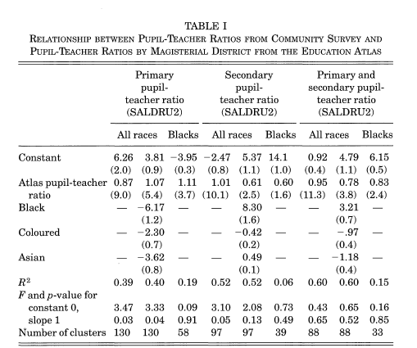
Data
  For all the regressions the Atlas pupil-teacher ratio is a strong predictor of the community level pupil-teacher ratio

Slide 12
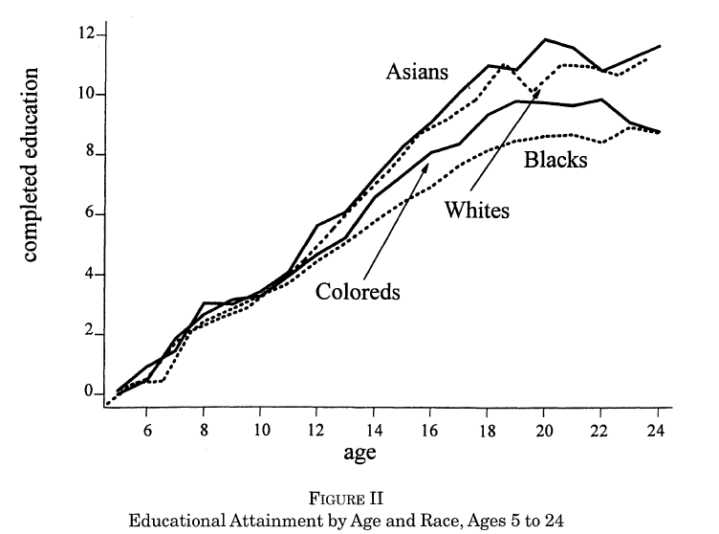
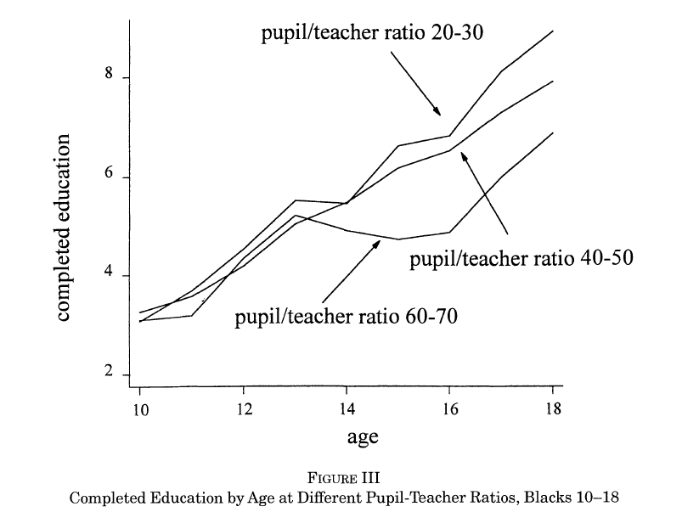
Inputs and Outputs
  FigureII:At age ten educational attainment does not differ much by race, but from ages ten to eighteen there is increasing dispersion between the races.
  FigureIII:
  ---Before age 13
  ---After age 13
  ---Beyond age 13, after which students must pass a provincewide examination in order to advance to the next grade

Slide 13
Inputs and Outputs
  The survey also gives the most important reason for nonenrollment for those between the ages of 7 and 24:
  Blacks 21.4 percent report "expense" as the main reason for nonenrollment; none of the Whites or Asians give this reason.
  "Illness," "pregnancy," and "could not cope with school work"
  For "expense": structure and size
  ---Black HH: 40 Rand a month ( 2.9 percent of total expenditure)
  ---White HH: 248 Rand a month (4.6 percent of total expenditure)
  ---the share of educational expenses in the budget is larger for Whites.

Slide 14
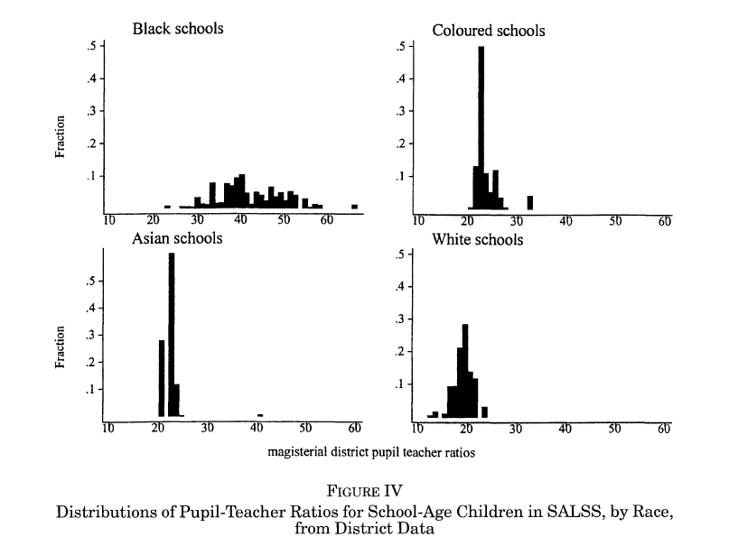
Inputs and Outputs
  Figure IV shows summary information for the pupil-teacher ratios from the Atlas data as merged into the SALSS sample.
  Pupil-teacher ratios are much more dispersed within the Black population than is the case for the other group.

Slide 15
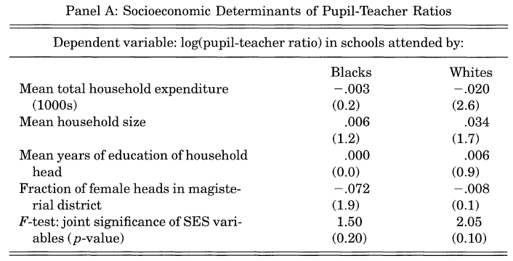
Inputs and Outputs
Regress the log (pupil-teacher ratio) by magisterial district on mean characteristics (by race) of each district.
For Blacks, there is no relationship between the log (pupil-teacher ratio) and the mean total household expenditure as well as parent's taste for education. (proof of preassumption)
For Whites, outcome somewhat different.(low mean and low variability of pupil-teacher ratios among Whites)

Slide 16
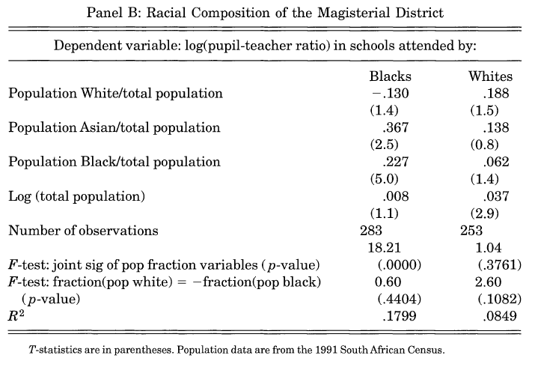
Inputs and Outputs
Panel B of Table III shows that pupil-teacher ratios among Blacks are significantly affected by the racial composition of the district as measured in the 1991 census
For Black schools the racial composition is a significant determinant of the district's pupil-teacher ratio, and the larger the fraction Black, the more pupils for every teacher.
In contrast, the racial composition of the district plays no role in the allocation to White schools.

Slide 17
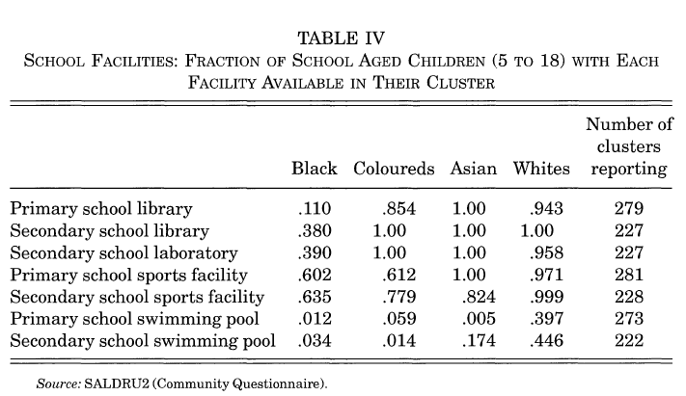
Inputs and Outputs
The results confirm that it is not only pupil-teacher ratios that are unequally allocated

Slide 18
Empirical Analysis
In this section the author examines the relationship between school inputs, particularly the pupil-teacher ratio, and various measures of educational outcomes, including educational attainment, enrollment rates, the reasons for not being in school, educational expenditures, and test scores.

Slide 19
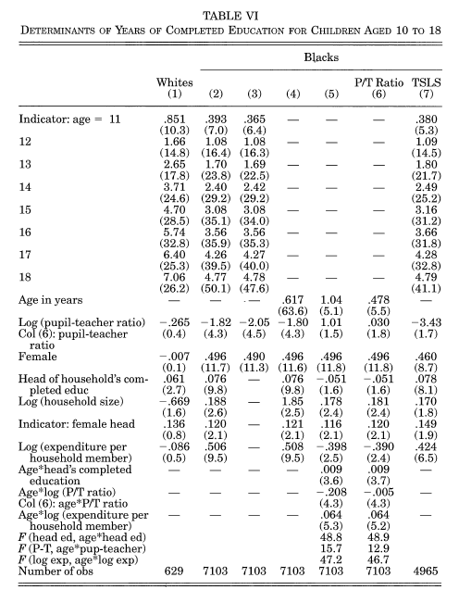
Empirical Analysis
For the first two vectors:
---The differences between successive dummies would be unity if each child moved with certainty from one grade to the next,
---For Whites:the differences are 0.81, 0.99, 1.06, 0.99, 1.04, 0.96, and 0.66
---For Blacks, the differents vary from 0.48 to 0.70; average is 0.6(Black child obtains only two-thirds of a year of education for each additional year of age)

Slide 20
Empirical Analysis
Pupil-teacher ratio :
---For both group it has a negative impact,one is significant,the other is not;
---the difference in the effects between Whites and Blacks (coefficients) is that the effect of additional resources is nonlinear, the decreases in the pupil-teacher ratio have a much larger effect when there are 40 (or 60) pupils per class than when there are 20
Gender and household characteristics have important effects in the regressions.
Head's education is a strong predictor of educational attainment among both Blacks and Whites

Slide 21
The two most interesting contrasts are in the effects of resources: private resources through expenditure per head, and public resources through the pupil-teacher ratio.
Household resources(expenduture,income) :
---they have no effect on the educational attainment of White children, but a marked positive effect on the education of Blacks;
---education is cheap enough so that funding is not a constraint for Whites but can be a serious constraint for the much poorer Blacks.
Public Resources(pupil-teacher ratio):
---The same appears to be true for the pupil-teacher ratio, whose strong negative effect is confined to Black pupils.
---For the Black students, where the pupil-teacher ratios in primary and secondary schools are more than twice as big, higher pupil-teacher ratios as Whites have a strong and significant negative effect on attainment; however,the pupil-teacher ratio has no obvious effect on educational attainments of White children.

Slide 22
Empirical Analysis
Compared vector (2) with vector (3) :
---Although these are significant in the regression in vector (2), their removal does not affect the other coefficients, and in particular does not alter either the size or significance of the pupil-teacher ratio. These results are what we would expect from Table III, which showed negligible effects of family background variables on the pupil-teacher ratios

Slide 23
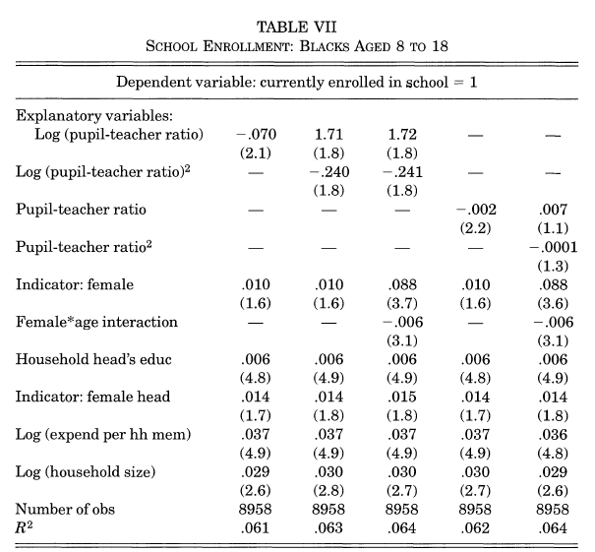
Enrollment Rates and Reasons for Nonenrollment
Table VII shows estimates of linear probability models for enrollment status. These are run for Blacks aged from eight through eighteen inclusive. A dummy variable is regressed on the pupil-teacher ratio and the family background variables, together with (not shown) a series of age indicators and urbanization dummies.

Slide 24
Enrollment Rates and Reasons for Nonenrollment
The results are qualitatively consistent with findings on educational attainment in Table VI, particularly as concerns the effects of public and private resources on education.
The log of the pupil-teacher ratio has a significant negative effect on the probability of being in school.
And in both cases, household resources enhance education,such that the household head's education level.

Slide 25
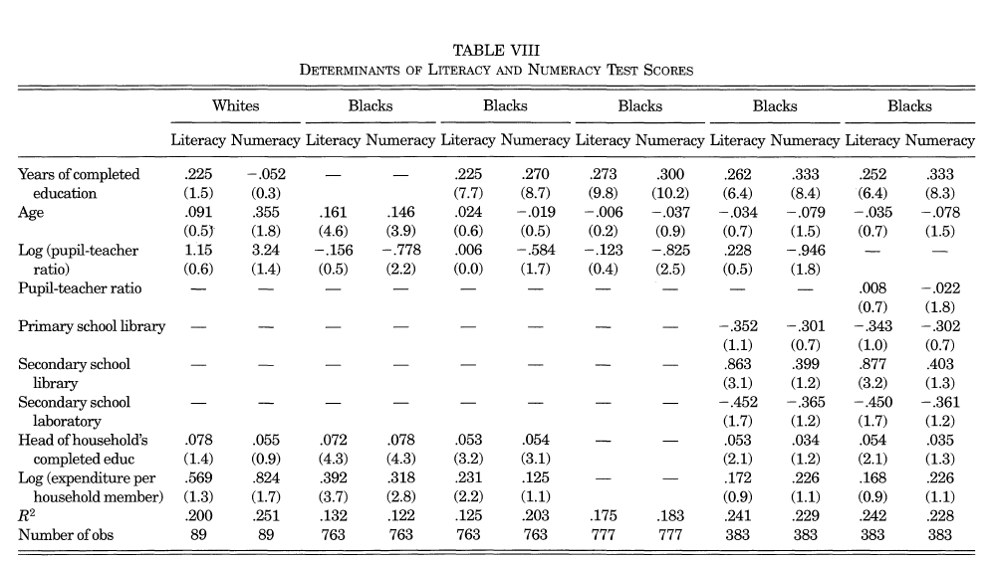
Determinants and Effects of Test Scores
Using the much smaller sample of individuals who took the comprehension and numeracy tests appended to the main survey
Testing the indepedent variables's effects on Test Scores.
For Whites,there are no significant effects of any of the variables on either of the two scores.
For Blacks, there's a obvious multicollinearity in regression.

Slide 26
Conclusion
On the eve of democratic elections in South Africa,educational resources were (and are) sharply different by race,which provide a effective date base on educational research.
Poorly resourced schools, defined as those with high pupil-teacher ratios, discourage educational attainment conditional on age, lower test scores, and lower the probability of being enrolled in education.
The effects of the pupil-teacher ratio on attainment and enrollment are confined to Blacks, consistent with the view that at the small class sizes that characterize education for the other racial groups, reductions in class size have little or no effect.
Pupils in better-off Black households do better in their education, and there's no parallel for Whites

Slide 27
Conclusion
These results differ sharply from what is often thought to be a consensus, that school resources do not matter very much.
Hanushek [1995] writes "research demonstrates that the traditional approach to providing quality--simply providing more inputs--is frequently ineffective", in which he used lots of cited review and meta-analysis.
Hanushek's conclusion is cited by officials in South Africa in support of the current policy of aiming for class sizes that are closer to apartheid levels for Blacks than those for Whites.
The author argues that the studies included in the meta-analyses are of very mixed quality: many have never been peer reviewed, some are no longer available

